Slide 1
Annual Certifications

Slide 2
Completing an Annual Certification Form
The purpose of the Annual Certification is to ensure that faculty have reported all of their external activities and financial relationships in order for the University to review their Emory activities. This report helps the Conflict of Interest Review Office and the Deans determine an appropriate management plan if a potential conflict exists.
All full-time and part-time faculty engaged in research and/or scholarly activities, and all Emory Healthcare Physicians must complete an Annual Certification.
Dean and Manager level staff at the School of Medicine should contact the office of Industry Relations at (404) 727-3407 to determine whether they are subject to a School of Medicine policy that requires their completion of an Annual Certification.

Slide 3
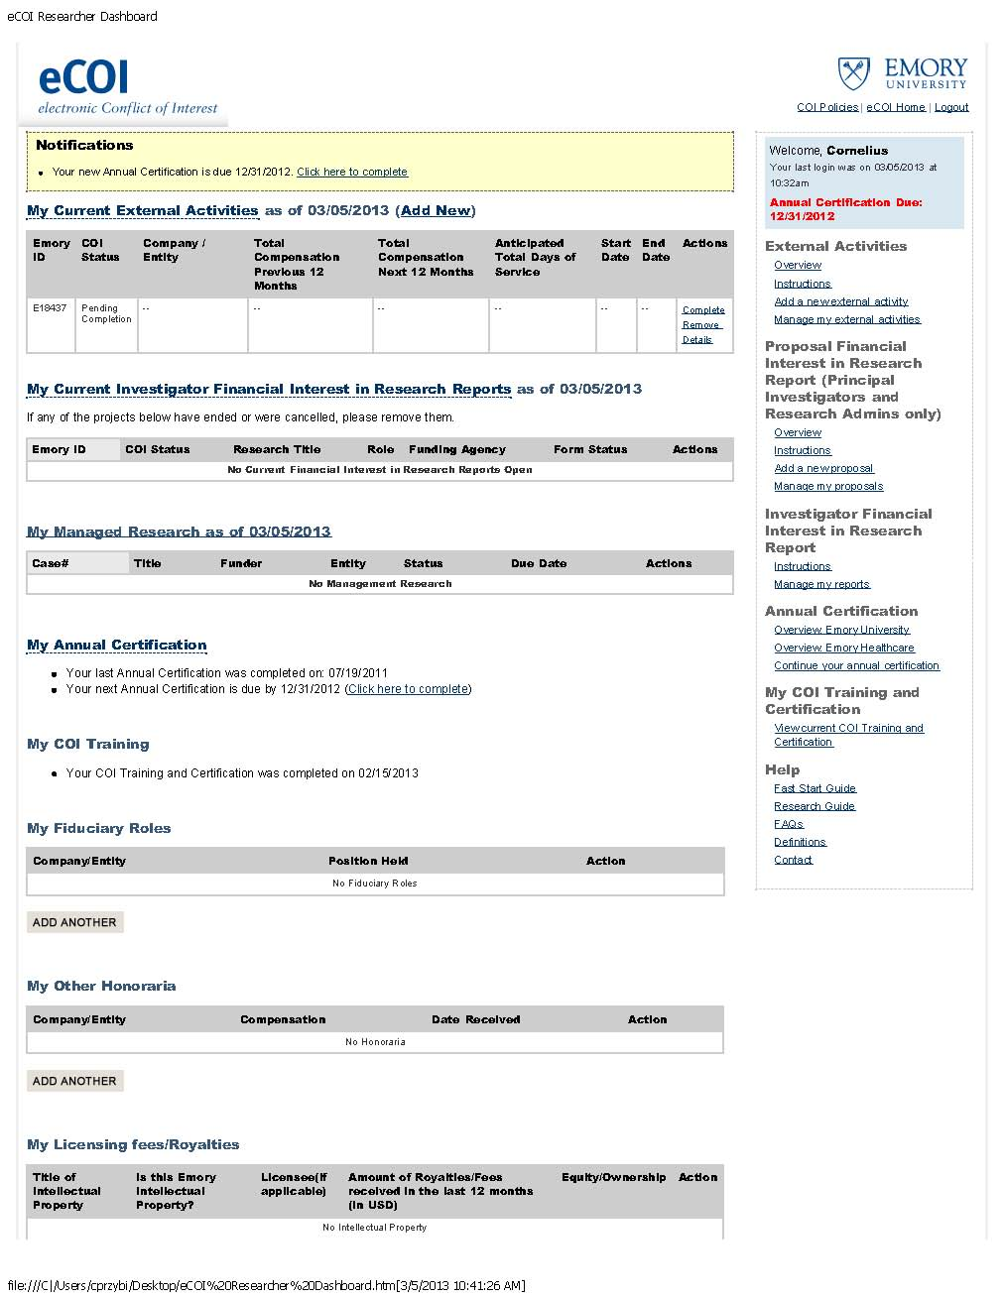
Instructions
1. Click on any one of three links to the form on the eCOI home page.
2. The next page will be a general overview of Annual Certifications. Please read this page carefully.

Slide 4
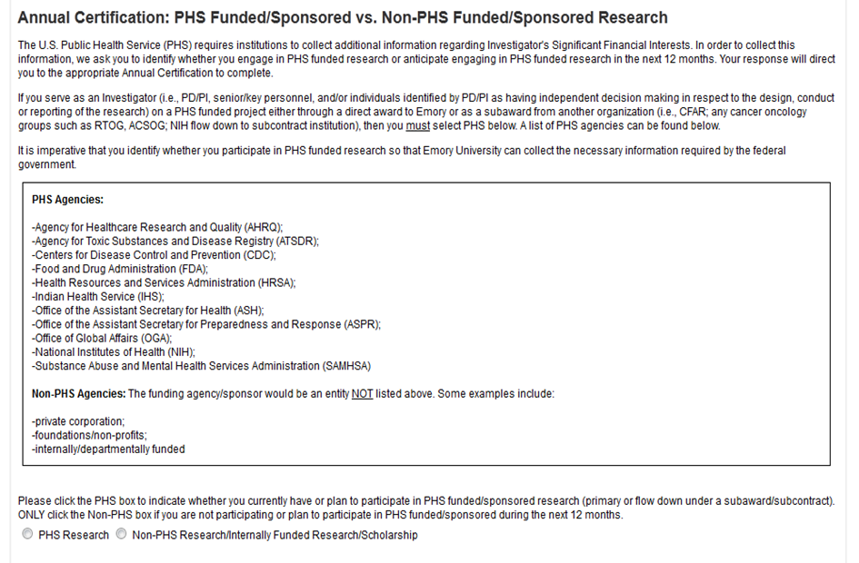
3. After reviewing the overview page, click “continue” to the next page where you must determine whether or not you are involved in US Public Health Service funded research.
4. After making this determination, click the appropriate button in order to be directed to the correct reporting form. If you do not participate in any sponsored research, you should select “Non-PHS”.

Slide 5
Complete the Annual Certification. Review each section, update information as necessary and answer every question within the school/unit pages.
After completing the form, a summary of your answers should appear on your computer screen. Once you have made sure that all of your answers are accurate, type your name in the certification box and click “certify” at the bottom of the page.
Any changes to information collected through the Annual Certification Reports must be made within thirty days. The changes should be made through the eCOI system.

Slide 6
Need Additional Help?
Contact Emory’s Office of Research Administration for University Policy information:
1599 Clifton Road
6th Floor East
Atlanta, GA 30322
Phone: (404)712-0046
Fax: (404)712-0069
Email: COI-OFFICE@LISTSERV.CC.EMORY.EDU
Website: http://www.coi.emory.edu
Emory Mailstop: 1599 -001-1BU
Financial interests and clinical activities:
Please contact the Office of Compliance Programs at (404) 778-2757
External activities and school-based policies, please contact your Dean’s Office:
School of Medicine Nell Hodgson Woodruff School of Nursing
Zainab Wurie Harvey, JD Sandra B. Dunbar, DSN, FAAN
zwurie@emory.edu sbdunba@emory.edu
404-727-3407 404-727-6936
Emory College/Graduate Arts & Sciences Goizueta Business School
Carla Freeman, PhD Kristy Towry, PhD
cfree01@emory.edu kristy.towry@emory.edu
404-727-6059 404-727-4895
Rollins School of Public Health School of Law
Dean Surbey, MBA Polly J Price, JD
psurbey@emory.edu pprice@emory.edu
404-727-3023 404-727-7869

